Slide 1
A n o v e r v i e w o f s e a r c h a n d m a t c h a l g o r i t h m s c o m p l e x i t y a n d
p e r f o r m a n c e
s arah M o hs e n f ahmy / D R : s ara e l - me tw al l y / ge no mi c s

Slide 2


ABSTRACT
DNA extracted from cells has huge amount of information about us. It distinguishes creatures and make them different. So, to do sequence matching that helps us to understand evaluation and genetic relationships, we have a lot of algorithms each of them has its performance and complexity.
INTRODUCTION
When we discover pattern in a specific string ,we have two main approaches of matching:
a. Exact matching:
For instance: Smith-waterman(SW),Needleman wunsch (NW), Boyer moore horspool(BMH).
Dynamic programming: Knuth morris pratt(KMP).
b. Approximate matching (fuzzy string searching):for instance like Rabin karp and Brute force.
We will analyze in this paper matching in protein, DNA and RNA.

Slide 3
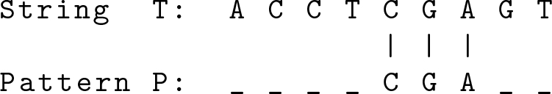
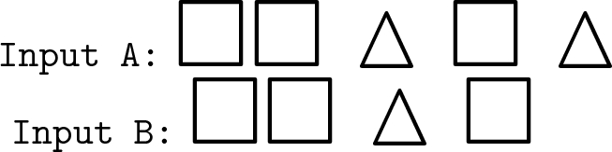
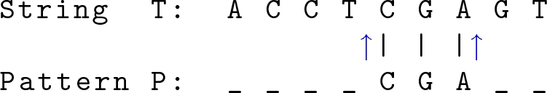
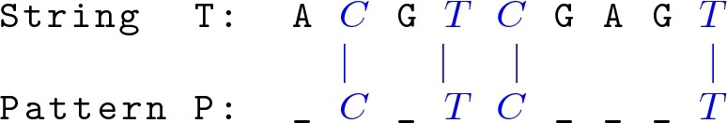
RELATED WORK
Pattern P can be matched in String T by adding four empty spaces before the pattern and two after.
In (Yeh and Cheng 2008), They used
Levenshtein distance applied to
images and videos to determine feature vectors. For instance:
To find maximum matches we remove last triangle in input A.
In (Amir et al. 2004),They proposed new string distance like Levenshtein
distance implemented with Message Passing Interface (MPI).
In (Knuth et al. 1977), This traditional algorithm is now known as KMP
string matching algorithm which used for pattern matching in strings.
In (Hussain et al. 2013), named Bidirectional Exact Pattern Matching
(BDEPM) which uses pointers in string matching.
In (Alsmadi and Nuser 2012), They evaluated two algorithms for DNA
string comparison. The Longest Common Substring (LCS) algorithm, and
Longest Common Sub-Sequence (LCSS) algorithms. In the following
example, the highlighted letters, CTCT, in the sequences is LCSS of the
specified sequences.
Different types of string matching algorithms are explored in (Singla and
Garg 2012), concluding that for string matching, Boyer Moore algorithm
is the best. In Aho-Corasick performs better than the CommentZ-Walter
algorithm.

Slide 4

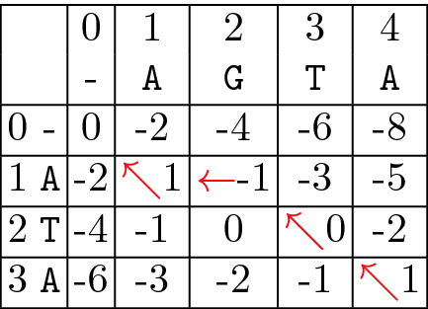
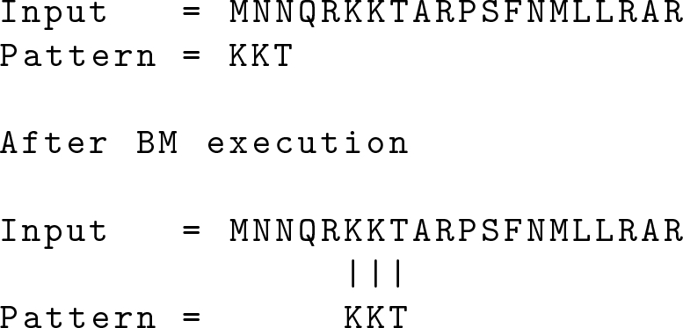
Methodology
Needleman Wunsch Algorithm
The Needleman-Wunsch (NW) algorithm
(Needleman and Wunsch 1970) is a Dynamic
Programming (DP) algorithm that solves the
problem of sequence alignment. for finding
the optimal alignment between two
sequences, the maximum score of this function is needed to
compute and the alignment that yields it.
Boyer Moore Algorithm
Boyer Moore algorithm (BM) for string search and match is a standard
benchmark algorithm, considered one of the most efficient when the
alphabet comprises a small size of characters, used on standard editors to perform string search. So this algorithm is often used in bioinformatics for disease detection.
Results
In this survey are analyzed different string matching algorithms in the context of biological sequence, DNA and Proteins.
Boyer More is faster when using large sequences, avoiding many
comparisons. Boyer More in best case scenario complexity is sub-
linear. As future work, it is proposed a parallel algorithm for
fuzzy string matching, using artificial intelligence neural networks
for better performance and accuracy.

